Slide 1



Enhancing Breast Cancer Diagnosis
Group 33
Mahammad Thufail
Sai Shirini Prathigadapa
Rekha Anvitha Inturi

Slide 2
Contents
Introduction
Project Approach
Data Source
Project Execution
Conclusion

Slide 3
Introduction
Section 1

Slide 4



Motivation:
The high prevalence and variability of breast cancer make diagnosis challenging yet critical for effective treatment.
Significance:
Utilizing PCA and clustering techniques can significantly refine diagnostic accuracy and help in understanding tumor characteristics, aiding in personalized treatment approaches.

Slide 5
Comprehensive analysis using dimensionality reduction and clustering on diagnostic data.
Project Scope
Improving the accuracy and timeliness of breast cancer diagnoses through advanced data techniques.
Project Focus

Slide 6
Project Approach
Section 2

Slide 7
Principal Component Analysis (PCA):
To reduce dataset dimensionality and focus on principal components that capture the most variance.
PCA simplifies the dataset by transforming it into a set of linearly uncorrelated variables (principal components), which facilitates a clearer understanding of the data structure
Techniques Used
To Delve into the complexities of breast cancer diagnosis and treatment.

Slide 8

Clustering Techniques:
K-Means Clustering:
Identification of patient groups based on tumor characteristics.
Hierarchical Clustering:
To visualize hierarchical relationships among patient cases.
Techniques Used
To Delve into the complexities of breast cancer diagnosis and treatment.

Slide 9
Data Source
Section 3

Slide 10
The dataset for this project is sourced from the Breast Cancer Wisconsin Diagnostic dataset, available on the UCI Machine Learning Repository.
It provides detailed information about breast cancer cell characteristics derived from digitized images of fine needle aspirates (FNAs) of breast masses. With 569 observations and 32 variables, including radius, texture, and concavity, it offers valuable insights into cell nuclei features.
Dataset: https://archive.ics.uci.edu/dataset/17/breast+cancer+wisconsin+diagnostic

Slide 11
Project Execution
Section 4

Slide 12
Data Loading and Initial Setup:
Loaded the Breast Cancer Wisconsin (Diagnostic) dataset using R, with specific column names assigned to ensure clarity in the dataset's structure.
Preprocessing Steps:
Checking for Missing Values:
Ensured data integrity by checking for missing values across all variables, confirming a complete dataset with no missing entries.

Slide 13
Exploratory Data Analysis (EDA):
Conducted initial analysis to understand the distribution of diagnostic outcomes (Benign vs. Malignant).
Utilized ggplot2 for visualizing the frequency of diagnoses, providing insights into dataset balance.

Slide 14
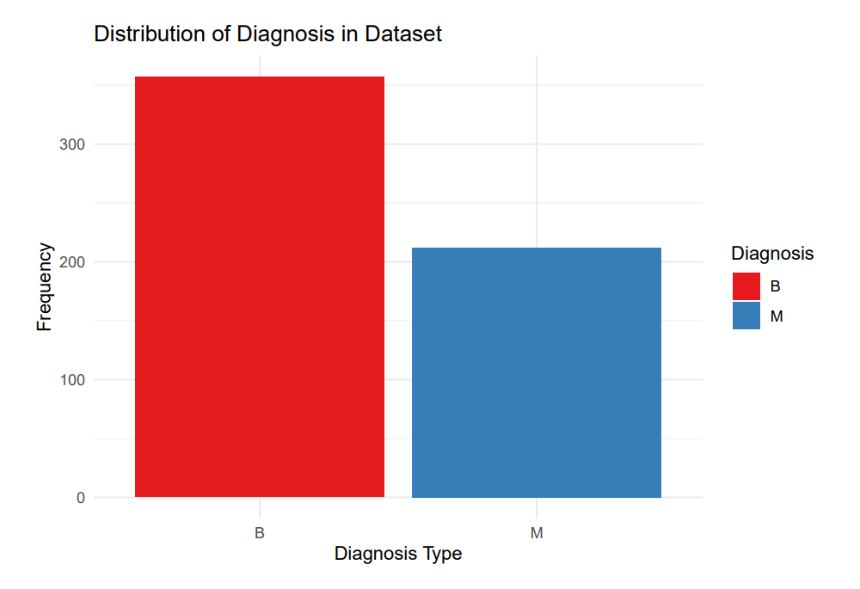

Slide 15
Feature Overview:
Categorized the 30 numeric variables into three groups (_mean, _se, _worst) to capture different statistical dimensions of the data.
Summarized the number of features in each category and the total observations, aiding in the subsequent analytical phase.

Slide 16
Correlation Analysis :
Computed the correlation coefficients for all pairs of the 30 features in the dataset, focusing on the mean, standard error, and worst values of each characteristic.
Used Pearson correlation to quantify the linear relationships between variables.
Employed corrplot package in R to generate a color-coded correlation matrix.

Slide 17
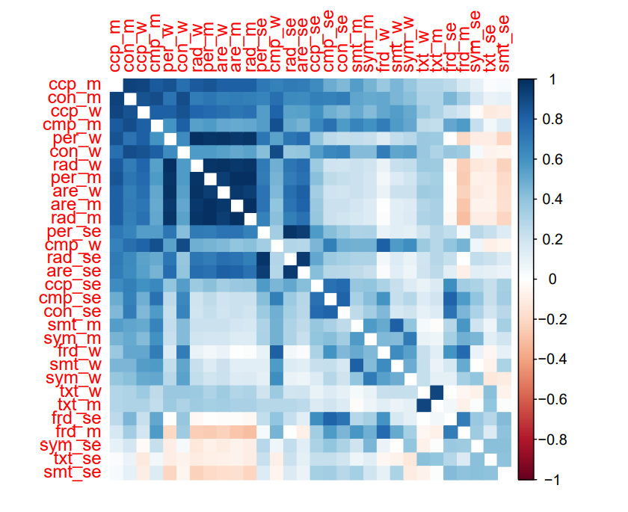
Identified strong positive and negative correlations:
High positive correlations were observed among size-related features (like radius, perimeter, and area), suggesting redundancy in information which could be compressed via PCA.
Notable negative correlations might indicate inverse relationships essential for nuanced analysis and interpretation.

Slide 18
PCA and Clustering Implementation

Slide 19
Principal Component Analysis (PCA):
Standardization of Data: Normalized the data to prevent attribute scale disparities from influencing the analysis.
Execution and Interpretation:
Performed PCA to reduce dimensionality, focusing on capturing the most variance with fewer components.
Analyzed and visualized the variance explained by each principal component to determine the number of components to retain.

Slide 20
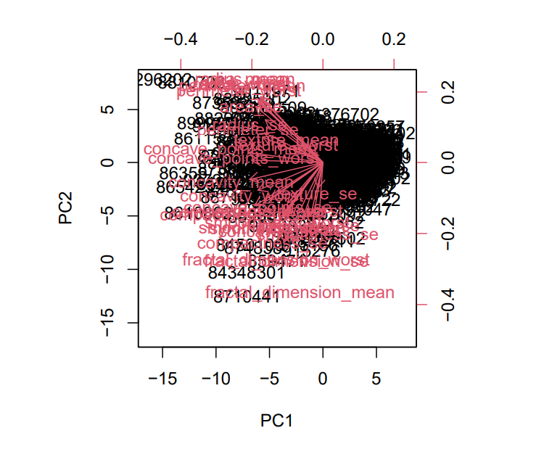
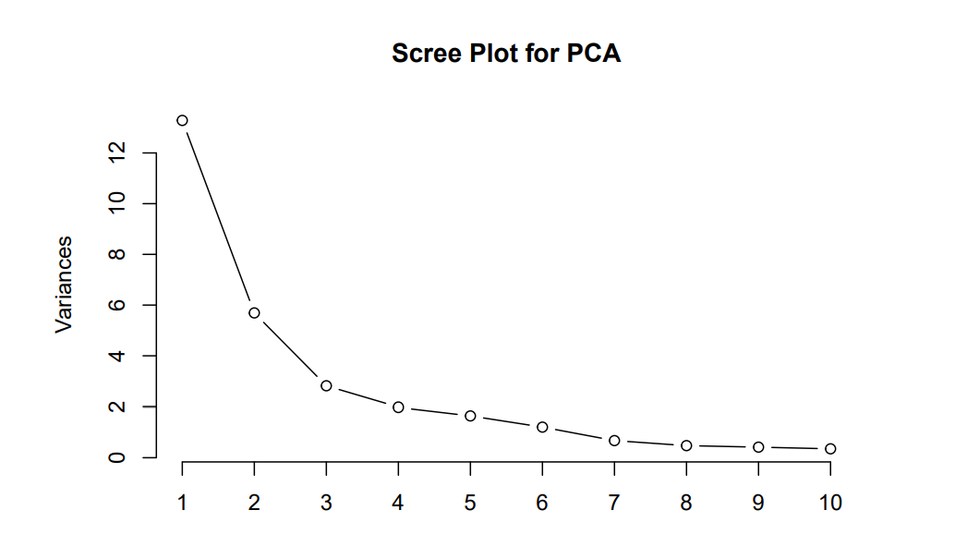

Slide 21
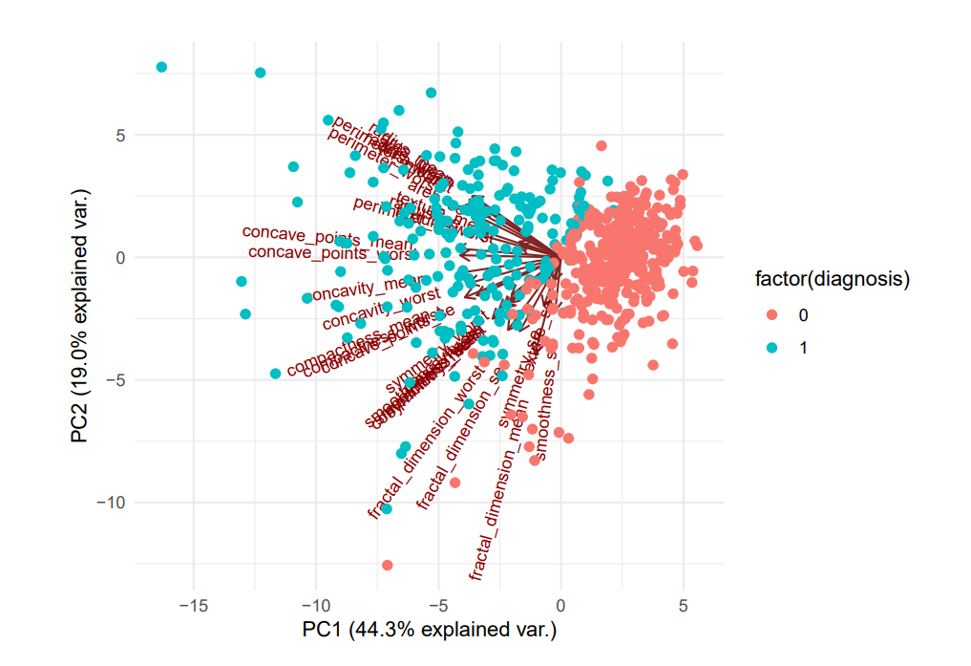
The PCA biplot visualizes the distribution of breast cancer cases, where the first two principal components explain 63.6% of the variance.
The plot distinguishes between benign (0) and malignant (1) diagnoses, with arrows indicating the contribution of various features to these components, highlighting how characteristics like concavity and concave points are strongly associated with malignant cases.

Slide 22
Clustering Analysis:
Hierarchical Clustering:
Implemented hierarchical clustering using complete linkage to measure the maximum distance between observations in different clusters.
Dendogram :
Constructed a dendrogram to visualize the hierarchical relationship between samples, providing a clear view of how clusters merge.
Opted to cut the dendrogram at four clusters, a decision based on the natural grouping observed in the dendrogram.

Slide 23
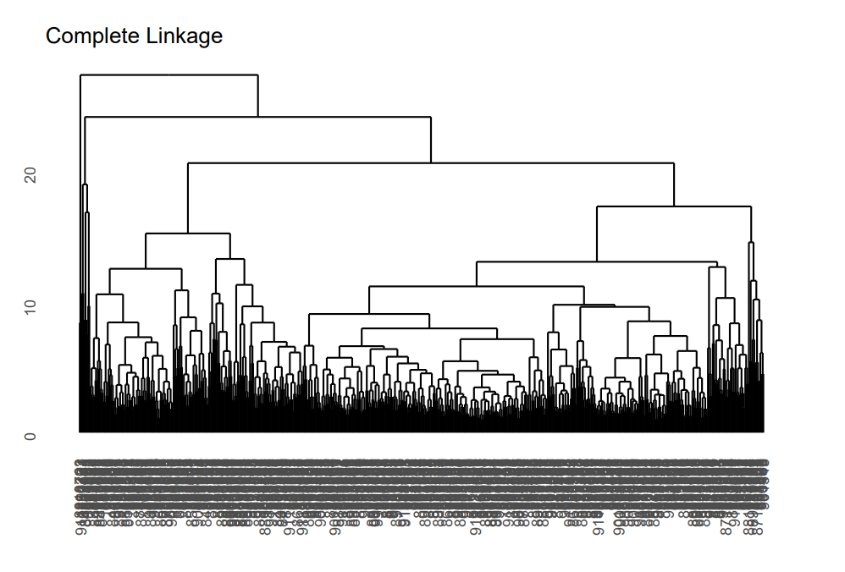
The clustering accuracy for this method was found to be 90.5%, indicating a high level of agreement between the cluster assignments and actual diagnoses.

Slide 24
K-Means Clustering Analysis :
Applied K-Means clustering, testing a range of cluster counts from 1 to 10 to determine the optimal number.
Utilized the Elbow Method to identify the most appropriate number of clusters by observing the within-cluster sum of squares (WCSS).
Elbow Method :
Determined that the elbow point occurred at two clusters, indicating significant reduction in WCSS up to this point, beyond which the reduction becomes marginal.

Slide 25
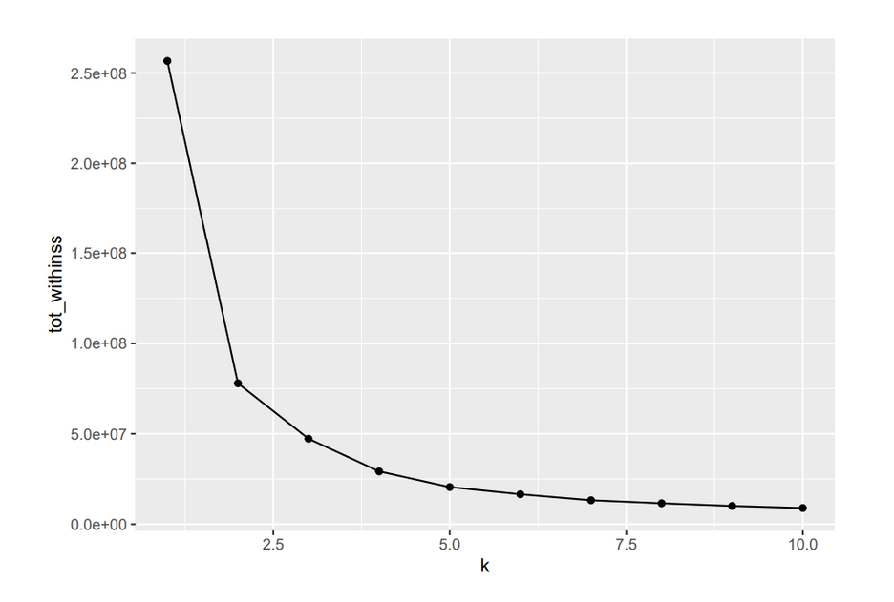
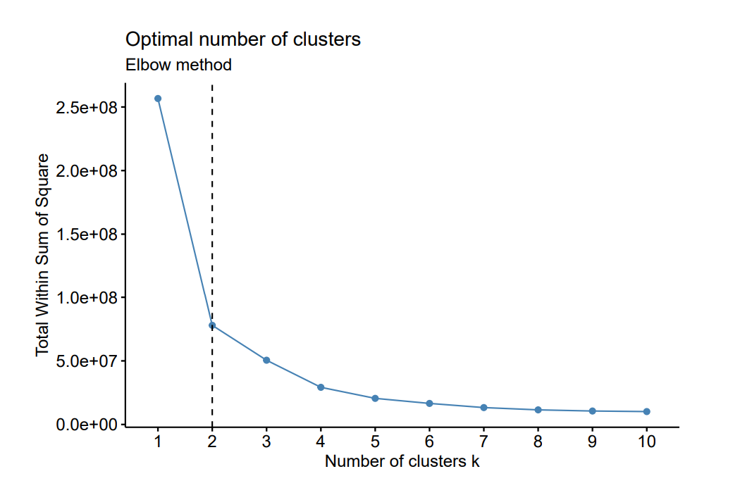
The clustering accuracy for K-Means with two clusters was calculated at 91.04%, demonstrating the effectiveness of the model in segregating benign from malignant cases.

Slide 26
Clustering on PCA-Reduced Data :
After reducing dimensionality through PCA, applied hierarchical clustering to the transformed data, focusing on the principal components that captured the most variance.
This approach ensures clustering is based on the most significant underlying patterns without the noise of less informative variables.

Slide 27
Conclusion
Section 5

Slide 28
Project Summary :
Effective Dimensionality Reduction:
Utilized Principal Component Analysis (PCA) to reduce the complexity of the Breast Cancer Wisconsin (Diagnostic) Dataset. Despite reducing the dimensionality significantly, the critical variance within the data was maintained, allowing for efficient and insightful analysis.
High Model Accuracy:
Achieved impressive clustering accuracy rates with both hierarchical and K-Means clustering on PCA-reduced data.
The high accuracy demonstrates that even with reduced dimensionality, the models were able to discern and categorize underlying patterns effectively, distinguishing between benign and malignant diagnoses accurately.

Slide 29
Impact of Dimensionality Reduction :
This efficiency enables faster and more reliable diagnostic predictions, which are crucial for early intervention and personalized treatment strategies in oncology.
Dimensionally reduced data require less computational resources, facilitating quicker analyses and potential real-time diagnostic support in clinical settings. This not only speeds up the decision-making process but also reduces the computational cost, making it feasible for wider adoption in healthcare systems.

Slide 30
Future Perspectives:
Further Model Improvement:
While current results are promising, there is room for exploring more sophisticated machine learning techniques that could work synergistically with PCA to enhance both accuracy and interpretive power.
Integration into Healthcare:
Encourage pilot studies to integrate these models into clinical workflows, assessing their practical impact and user acceptance in real-world settings.

Slide 31


"Early detection saves lives"
DR. SUSAN LOVE
THANK YOU

